Slide 1


INSTITUTE OF ADVANCED COMPUTING AND SOFTWARE DEVELOPMENT, PUNE
PG-e-DBDA – May -2021
Olympic Data Analysis
Mr. Prashant Karhale
Center Coordinator
PROJECT GUIDE:-
Mr. AKSHAY TILKEKAR
SUBMITTED BY :-
1308_DIPALI BAMDALE
1310_DIKSHA KOLIKAL

Slide 2
Contents
Introduction
Dataset
Project Flow
Data Visualization
Training and Testing Set
Used Model
Conclusion

Slide 3
Introduction
The primary objective of this project is to analyze the Olympic dataset to compare the overall performance of countries and evaluate each country's contribution to the Olympics.
Based on existing data , the aim is to use machine learning algorithms to develop model for predicting the winning medals.

Slide 4
Dataset
Dataset contains information about Olympic games.
The Columns is used Dataset as follows :
ID
Name
Sex
Age
Height
Weight
Team
NOC
Games
Year
Season
City
Sports
Event
Medal

Slide 5
Project Flow
Testing
Dataset
2b
1b
Data
Training
Dataset
Algorithm
Evaluation
Prediction
1a
2a
4
5
3b

Slide 6
Project Flow Description
Get the Dataset and perform the cleaning process on it
After cleaning the data split it into two parts and apply the training and testing operation on the dataset
On the training dataset apply the Machine learning algorithm and evaluate it.
After evaluating apply next module and re-evaluate it and get the accuracy of the train test dataset
At the end of all process we can get the predicted result of the dataset

Slide 7
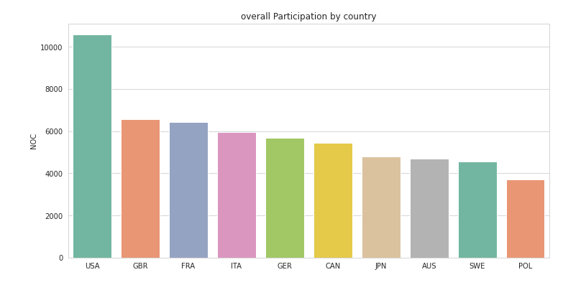
Data Visualization
Overall Participation of the country in the Olympic.

Slide 8
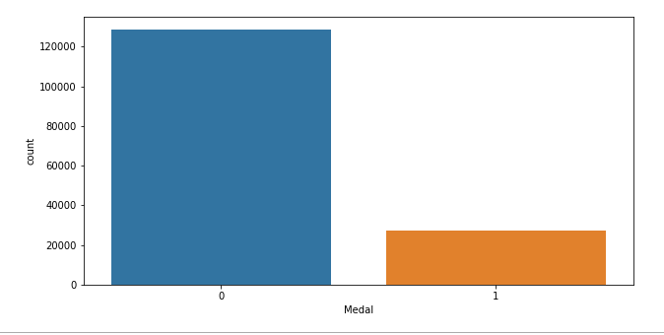
Count of the winning medals.

Slide 9
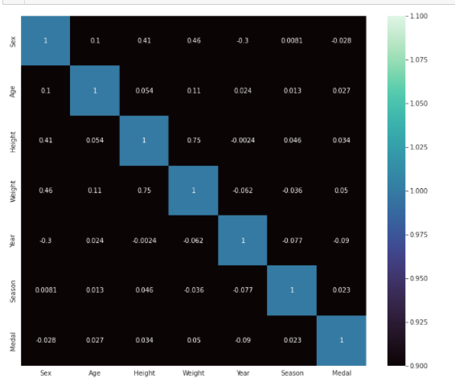
Correlation Matrix

Slide 10
Training and Testing Set
Separating data into training and testing sets is an important part of evaluating data mining models.
A training set is a set of data used to discover potentially predictive relationships.
A test set is a set of data used to access the strength and utility of a predictive relationship.
We have divided the original data, into training (70%) and test (30%) data sets.

Slide 11
Used Models
Random Forest :
Random forest is a flexible, easy to use machine learning algorithm that produces, even without hyper-parameter tuning, a great result most of the time.
Support vector machine (SVM) :
The main function of the SVM is to check for that hyper plane that is able to distinguish between the two classes.

Slide 12
Cont...
K-Nearest Neighbour (KNN):
KNN is a Supervised Learning Algorithm In supervised learning, you train your data on a labelled set of data and ask it to predict the label for an unlabeled point
Logistic Regression :
Logistic regression is a supervised learning classification algorithm used to predict the probability of a target variable

Slide 13
Models Score Table
Algorithm | Score
Random Forest | 0.9793
SVM | 0.8505
KNN | 0.7522
Logistic Regression | 0.7522
We can see among all these models Random Forest model has best fitted and gives best Score.

Slide 14
Conclusion
By performing different ML models, we got better accuracy with random forest regression model compared to other models.
Hence, This ML model is implemented to predict the winning medals.

Slide 15
Thank You …!

